Slide 1
AREC 213
Lecture 6: Financial and Accounting

Slide 2
AREC 213 Lecture 6
Financial Management
Financial management deals with two things: raising money and managing a company’s finances in a way that achieves the highest rate of return
This Lecture Focuses Mostly on
How a new venture tracks its financial progress through preparing, analyzing, and maintaining past financial statements.
How a new venture forecasts future income and expenses by preparing pro forma (or projected) financial statements.
Notes:
Example – should wheat farmer buy a combine or continue to hire a custom harvester?
Combine fixed costs = $21,270/year
Variable costs = $8.75/hour
Custom harvester charges $16/acre
5 acres harvested/hour
B/E = $21,270/($16/acre-$1.75/acre) = 1493 acres
Farmer would need to harvest 1493 acres per year to justify the investment

Slide 3
AREC 213 Lecture 6
Financial Questions
How are we doing? Are we making or losing money?
How much cash do we have on hand?
Do we have enough cash to meet our short-term obligations?
How efficiently are we utilizing our assets?
How do our growth and net profits compare to those of our industry peers?
Where will the funds we need for capital improvements come from?
Are there ways we can partner with other firms to share risk and reduce the amount of cash we need?
Overall, are we in good shape financially?

Slide 4
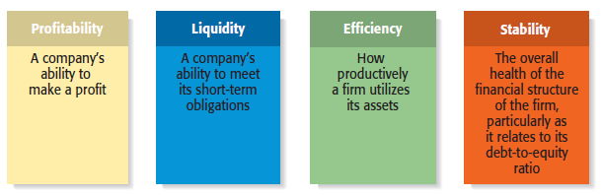
AREC 213 Lecture 6
Financial Objectives of a Firm

Slide 5
AREC 213 Lecture 6
Profitability
Is the ability to earn a profit.
Many start-ups are not profitable during their first one to three years while they are training employees and building their brands.
However, a firm must become profitable to remain viable and provide a return to its owners.

Slide 6
AREC 213 Lecture 6
Liquidity
Is a company’s ability to meet its short-term financial obligations.
Even if a firm is profitable, it is often a challenge to keep enough money in the bank to meet its routine obligations in a timely manner.

Slide 7
AREC 213 Lecture 6
Liquidity
Cash is the most liquid asset
Example: You owe your car payment of $300 on July 1st and have $120 in your bank account
You own a house worth $400,000
Real estate is not very liquid so even though you have something of value it does not help as readily to meet a short term cash obligation

Slide 8
AREC 213 Lecture 6
Efficiency
Is how productively a firm utilizes its assets relative to its revenue and its profits.
Southwest Airlines, for example, uses its assets very productively. Its turnaround time, or the time its airplanes sit on the ground while they are being unloaded and reloaded, is the lowest in the airline industry.

Slide 9
AREC 213 Lecture 6
Stability
Is the strength and vigor of the firm’s overall financial posture.
For a firm to be stable, it must not only earn a profit and remain liquid but also keep its debt in check.

Slide 10
AREC 213 Lecture 6
Importance of Financial Statements
To assess whether its financial objectives are being met, firms rely heavily on analysis of financial statements.
A financial statement is a written report that quantitatively describes a firm’s financial health.
The income statement, the balance sheet, and the statement of cash flows are the financial statements entrepreneurs use most commonly.

Slide 11
AREC 213 Lecture 6
Forecasts
Are an estimate of a firm’s future income and expenses, based on past performance, its current circumstances, and its future plans.
New ventures typically base their forecasts on an estimate of sales and then on industry averages or the experiences of similar start-ups regarding the cost of goods sold and other expenses.
Budgets
Are itemized forecasts of a company’s income, expenses, and capital needs and are also an important tool for financial planning and control.

Slide 12
Cash Flow

Slide 13
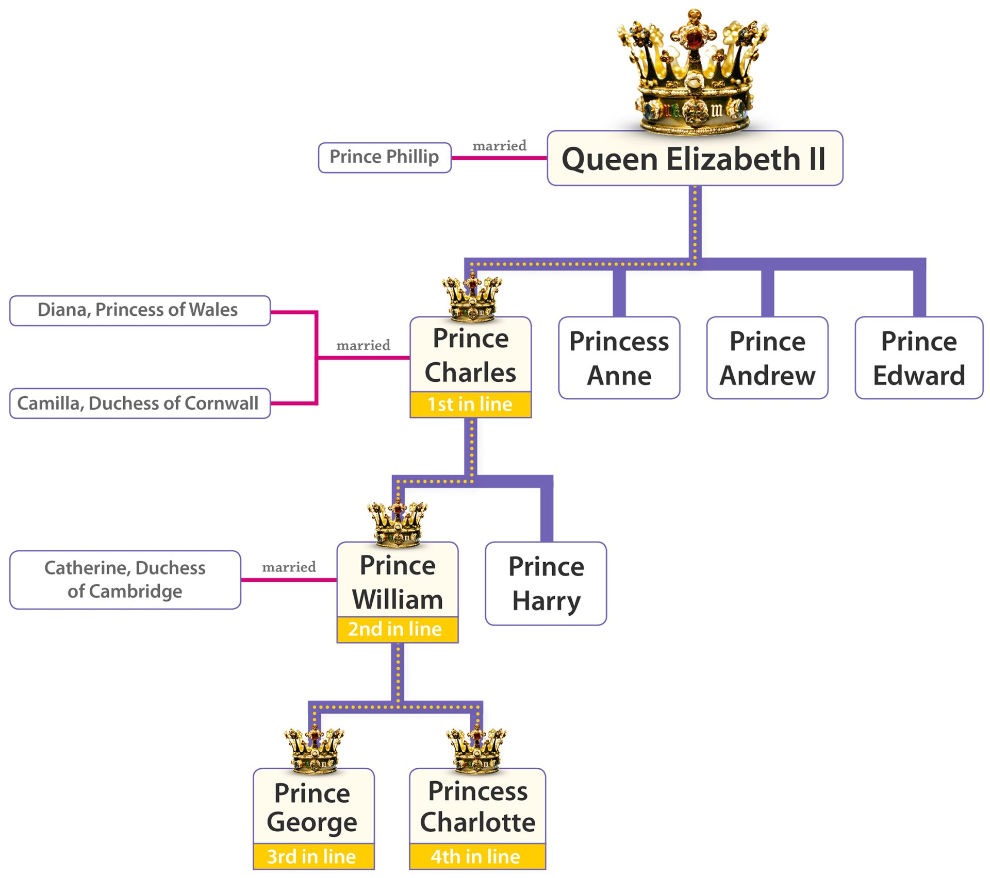

AREC 213 Lecture 6
What is Cash
Cash – Money on-hand, ready to use in your business.
Money in the bank
Checks received
Bank cards processed
Marketable securities, sometimes referred to as cash equivalents.
Cash is King!
You can think of cash flow a little like your business checking account
Notes:
Cash Flow –
Movement of cash into and out of a business
Payments to employees and suppliers
Collections from customers or cash sales

Slide 14
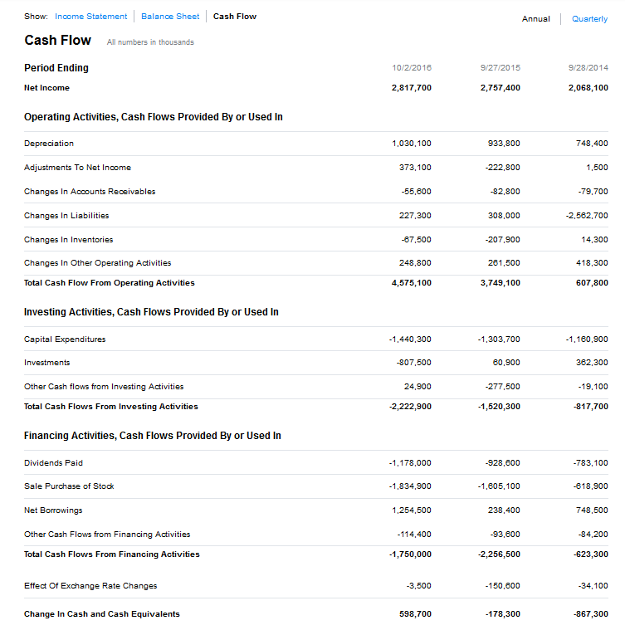
AREC 213 Lecture 6
Cash Flow
Movement of cash into and out of a business
Payments to employees and suppliers
Collections from customers or cash sales
Cash Position
The amount of cash and liquid investments a company has in the bank at any given point in time
Even for a Small Business Cash Flow can be global
Notes:
Cash Position –

Slide 15
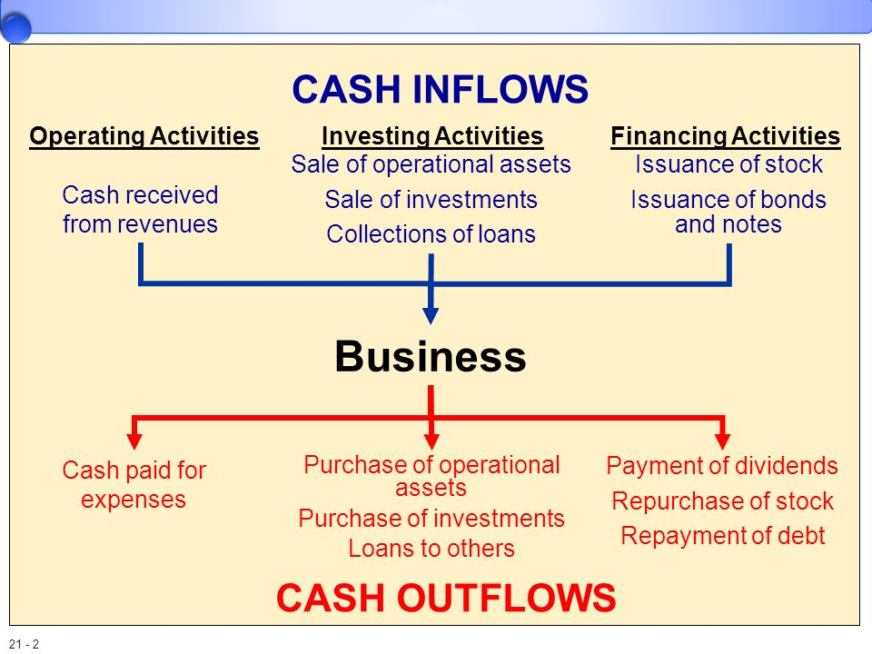
AREC 213 Lecture 6
Cash In Flow
Positive Stream of cash comes from
Operations
Cash paid by customers for services or goods
Financing
Taking on debt
Investing
A gain on invested Funds

Slide 16
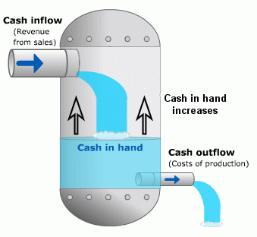
AREC 213 Lecture 6
Cash Out Flow
Negative stream of cash comes from
Operations
Expenditures from activities such as rent, utilities, payroll , COGS
Financing
Interest and principal payments, repurchase of stock, or issuance of dividends
Investing
Payments made into investments, loans to others , purchase of fixed assets

Slide 17
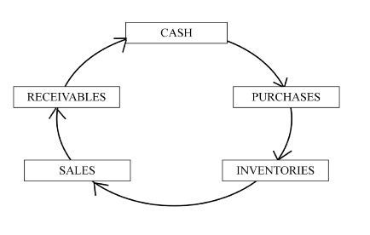
AREC 213 Lecture 6
Cash Cycle
Time it takes to put cash to use and convert back to cash.
Notes:
Cash Flow

Slide 18
AREC 213 Lecture 6
Initial Investment or Startup Costs
Amount of money being spent to start your business. Usually a negative number
Burn Rate
The amount of cash which is consumed by a business operating at a loss (start up operations).
Notes:
–
LIQUIDITY –

Slide 19
AREC 213 Lecture 6
Cash Flow Example
You finish college and go to work in a nursery, starting salary $2000 per month, beginning January 1st
You live at home, mom and dad pay all the bills and even loan you their extra car to use
You decide to move out February 1st.

Slide 20
AREC 213 Lecture 6
Cash Flow Example
Now What Happens?
It’s February 1st and you have direct deposit into your account
You have $2000 (Cash Inflow) to spend, CORRECT?
No, Your uncle Sam took his share first, $600 (Cash Outflow)
What is your cash position as of the morning of February 1st
Notes:
You go out and rent an apt. for $800 per month.
Utilities will be only $50.00 per month.
The lease terms are a 10% late fee on the 6th.
You need transportation so you lease a car for $200 per month along with insurance for $45 per month and gas for $100 per month; $50 on the 1st and $50 on the 16th. Late pmts. $20 after 5 days late.

Slide 21
AREC 213 Lecture 6
Cash Flow Example
You go out and rent an apartment for $800 per month
Utilities will be only $50 per month
The lease terms are a 10% late fee on the 6th
You need transportation so you lease a car for $200 per month along with insurance for $45 per month and gas for $100 per month ($50 on the 1st and $50 on the 16th)
Late pmts. $20 after 5 days late.
That night on the way home you remember you really need to go shopping this month so you spend $200, which will last the entire month of February.

Slide 22
AREC 213 Lecture 6
Cash Inflow | Morn. 2/1 | Even. 2/1 | 2/16 | 2/28
Work | 2000 | 0 | 0 | 0
Total Inflow | 2000 | 0 | 0 | 0
Cash Outflow
Taxes | 600
Rent |  | 800
Utilities |  | 50
Car Lease |  | 200
Auto Ins. |  | 45
Auto Fuel |  | 50 | 50
Food |  | 200
Total Outflow | 600 | 1345 | 50 | 0
Cash Pos. | 1400 | 55 | 5 | 5

Slide 23
Cash and Accrual
Based Accounting

Slide 24
AREC 213 Lecture 6
Cash and Accrual Based Accounting
Set of rules determining when and how income and expenses are reported
Selected at your first tax return

Slide 25
AREC 213 Lecture 6
Cash Based Accounting
Recognize income and expenses when you receive or pay them
Follows your bank balance
Notes:
Exceptions
Depreciation of Assets
If you are entitled to a payment in 2008 but choose to defer until 2009, you still need to recognize the income in 2008
Multi-year contracts must be split across the applicable years

Slide 26
AREC 213 Lecture 6
Accrual Based Accounting
Accrual accounting recognizes income in the year earned (rather than realized) and associates expenses with that income
Inventories and receivables, payables are the major differences from cash accounting
Example
Contract and pay in 2007 irrigation supplier for $20,000 system
System installed in 2008
$20,000 expense only deductible in 2008

Slide 27
AREC 213 Lecture 6
Cash Based Accounting
Most farms and horticultural businesses use cash accounting
Some must use accrual method
C Corporations (S Corps excepted)
Partnership with Corporation as partner
Businesses where inventories are required (excepting qualified taxpayers)
Crop Method
Hybrid of Cash and Accrual Methods
Deduct entire cost of crop production in year you realize income from crop

Slide 28
AREC 213 Lecture 6
Cash Based Accounting
Most farms and horticultural businesses use cash accounting
Some must use accrual method
C Corporations (S Corps excepted)
Partnership with Corporation as partner
Businesses where inventories are required (excepting qualified taxpayers)
Crop Method
Hybrid of Cash and Accrual Methods
Deduct entire cost of crop production in year you realize income from crop

Slide 29
AREC 213 Lecture 6
Cash Accounting
Simple
Allows for some flexibility in timing of expenses and revenues
Accrual Accounting
More accurate measure of annual production and income
Reduces income fluctuations

